Slide 1
MULTIMEDIA

Slide 2
HMTL MULTIMEDIA
Audio tag
Video tag
Embed
iframe / Youtube

Slide 3
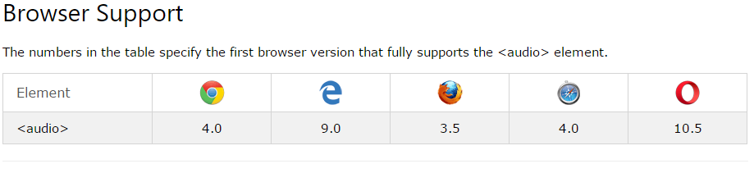
Audio on web
The HTML5 <audio> element specifies a standard way to embed audio in a web page. Similar to the img tag, its syntax is :
<audio controls src="media/birds.mp3"></audio>

Slide 4
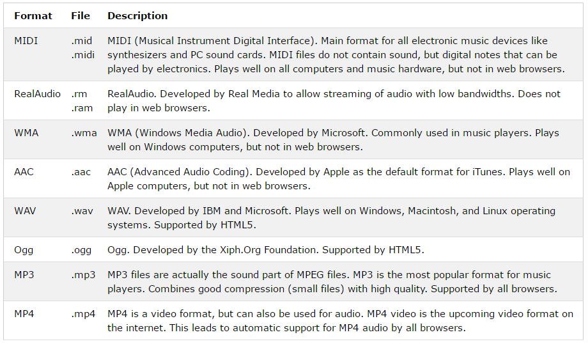
MULTIMEDIA FILE FORMATS

Slide 5
<audio controls>
<source src="myAudio.ogg" type="audio/ogg" />
<source src="myAudio.mp3" type="audio/mp3" />
<source src="myAudio.wav" type="audio/wav" />
Your browser does not support the audio tag
</audio>
To download some free short sound
https://pixabay.com/sound-effects/search/short/
The browser will attempt to play the ogg version and then play the mp3 version if it can not play the ogg format
But if the browser can not play any of the audio files, it will display the message on your browser
The text between the <audio> and </audio> tags will only be displayed in browsers that do not support the <audio> element

Slide 6
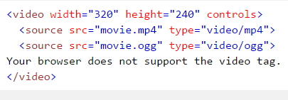
THE HTML <VIDEO> ELEMENT
To show a video in HTML, use the <video> element:
  Note that the video files must be existing at the location specified in the src
The nested source tag allows you state various file alternatives (different extensions)
The browser displays the text ‘Your browser does not support the video tag If it cant play any of the file (format) specified

Slide 7
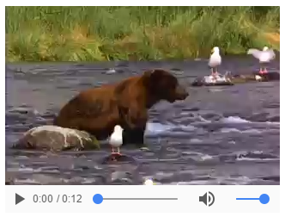
VIDEO TAG

Slide 8
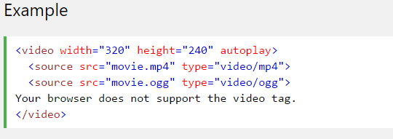
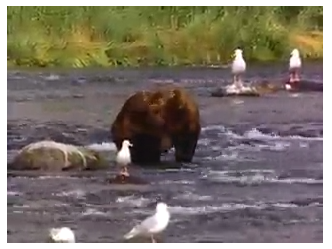
Using Autoplay
To start a video automatically use the autoplay attribute: (this often works when the attribute muted is present)

Slide 9
HTML LINKS (Anchor tags)
Navigating around your website…

Slide 10
HTML LINKS
Links are found in nearly all web pages. Links allow users to click their way from page to page.
You can click on a link and jump to another document.
The HTML <a> tag defines a hyperlink. It has the following syntax:
<a href="url">link text</a>
The most important attribute of the <a> element is the href attribute, which indicates the link's destination.
The link text is the part that will be visible to the reader.
Clicking on the link text, will send the reader to the specified URL address.

Slide 11
Link Colors:
By default, a link will appear in all browsers :
    An unvisited link is underlined and blue
    A visited link is underlined and purple
    An active link is underlined and red
  Example: On the Home page, we can create a link to the about us page by specifying as below:
    <a href=“aboutpage.html">About Us</a>
On the About page, we can create a link to the Home page by specifying as below:
<a href=“homepage.html">Home</a>

Slide 12
LINKS:
We can also add title attribute to our link to enable our users to know where the link is going to.
<a href="https://www.facebook.com" title="Go to Facebook">Visit our Facebook Page</a>
We can also use button to implement the linking.
<button onclick="document.location='default.asp’”>Facebook</button>

Slide 13
LINKING To Folders above and below
So far we have linked 2 pages together when they are both within the same folder. This is SCENARIO 1
There are other possibilities of a file linking to another file (SCENARIO 2); If a file wants to link to:
Another file A that is located in a foldername beside it: in this case, file A is below me. We write:
    <a href=“foldername/filename.html”>Link to File A Below Me</a>
  Another File A that is in a folder above me: in this case, I need to get out of where I am in order to see File A, we write:
    <a href=“../fileA.html”>Link to File a Above Me</a>
    To go out of where you are: use ../
    To go into a folder use: folder/

Slide 14
Global and Local link (Absolute vs. Relative URLs)
An absolute URL is one that takes the full web address in the href attribute. It uses the World Wide Web ("https://www" )
NOTE: It is also good that external links are opened in a new tab
A local link (a link to a page within the same website) is specified with a relative URL (without the "https://www" part):
Example
    <h2>Absolute URLs</h2>
    <p><a href="https://www.facebook/">Facebook</a></p>
    <p><a href="https://www.google.com/">Google</a></p>
    <h2>Relative URLs</h2>
    <p><a href="index.html">Home</a></p>
    <p><a href="aboutpage.html">About Us</a></p>

Slide 15
HTML Links - The target Attribute
NOTE: By default, the linked page will be displayed in the current browser window. To change this, you must specify another target for the link.
The target attribute specifies where to open the linked document.
The target attribute can have one of the following values:
_self - Default. Opens the document in the same window/tab as it was clicked
_blank - Opens the document in a new window or tab
_parent - Opens the document in the parent frame
_top - Opens the document in the full body of the window

Slide 16
Example:
<a href="https://facebook.com/" target="_blank">Visit Facebook!</a>
Question: Where do you think this link will take us to? Same webpage or a different one?

Slide 17
Link and Image
We can also use a link on our images such that when the image is clicked, it takes the user to another page
The simple syntax for this:
<a href="">
<img src="" alt="" style="">
</a>

Slide 18
Link and Email Address
Use mailto: or tel: inside the href attribute to create a link that opens the user's email program that allows them send a new email and to allow them open phone directly to the number in the tel: href.
<a href="mailto:someone@example.com">Send email</a>
<a href="tel:027426474"> 027426474 </a>
Try it You
Link and Titles
The title attribute specifies extra information about an element. The information is most often shown as a tooltip text when the mouse moves over the element.
Example
<a href="https://www.facebook.com" title="Go to Facebook">Visit Facebook</a>

Slide 19
Quick Class Exercise
Create two webpages, link them together such that users can navigate between both. Make each page have image and text, a lot of text using four paragraph tags.
Quick lorem shortcut – lorem100
15 mins.

Slide 20
LINKING TO SPECIFIC PARTS OF A WEBPAGE
It is possible to link to a specific part of an HTML document, rather than just to the top of the document.
To do this you first have to assign an id attribute to the element you want to link to.
Specify the link and add the id preceded by a hash symbol.
For example: <a href='#likes'>Hobbies</a> means that when a user clicks on Hobbies, they will be on the same page, but will be taken to the part where there is a tag with attribute id=‘likes’. Note that the tag can be any tag, for example it might be : <p id=‘likes’>This paragraph talks about what I like doing…</p>

Slide 21
Quick Class Exercise
Now update your recent class exercise by adding two menu links at the top of each page and make it link to different section of that page when clicked.
10 mins.

Slide 22
Adding Favicon to your webpage
A favicon is a small image displayed next to the page title in the browser tab. You can create your own favicon from https://favicon.io
The favicon is added to your webpage in the head session of the page using the link tag.
<!DOCTYPE html>
<html>
<head>
<title>My Page Title</title>
<link rel="icon" type="image/x-icon" href="/images/favicon.ico">
</head>

Slide 23
HTML AND THE STYLE ATTRIBUTE
An attribute with multiple values…

Slide 24
THE STYLE ATTRIBUTE
Browsers have a default way of displaying HTML tags. For example the <p> is always black, takes up the entire width etc (on any and every browser!)
You can use the style attribute to tell the browser how HTML elements are to be displayed
It is just another attribute, but it allows you to specify more than one property unlike others like height, align which specify certain one property per time. Each property is separated by semi colon.
Syntax is as shown below:
<tag style=“property:value; property:value;”> Content </tag>
It can be applied to any tag
Example in setting font color is, <tag style=“color:red”> contents </tag>

Slide 25
An anchor tag with the download attribute
<a href=“dogpic.jpg" download> <img src=“dogpic.jpg”> </a>
You can also decide what your file will be downloaded as. E.g,
  Pdf
  textDoc
  images
<a href=“cv.pdf" download=“JamesCV”> CV </a>

Slide 26
CSS Float Property
The CSS float property is a positioning property. It is used to push an element to the left or right, allowing other element to wrap around it. It is generally used with images and layouts.
The float has two major properties. The float and the clear. The property specifies whether an element should float or not. It has values as
float: left | right | initial | none | inherit;

Slide 27
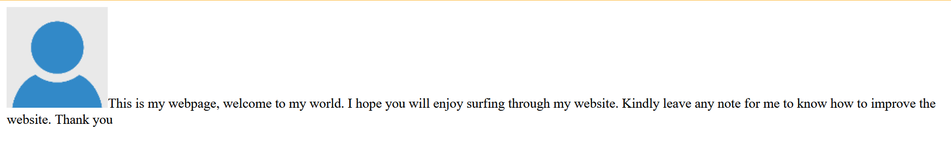
The Float Property
  Recall that the <img> is an inline element, two inline elements such as <img> and <span> can stand side by side.
  However, placing an image and a <span> tag side by side is not attractive. See example below:
    img {
    float: left;
    }

Slide 28
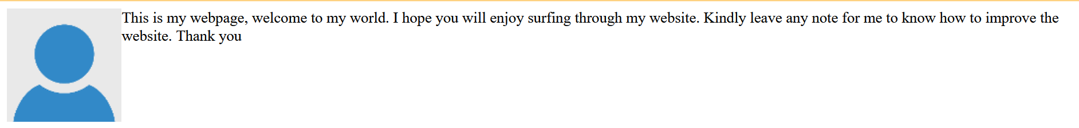
The Float Property
  The Float property can be used to make text wrap around an image.
  Demonstrating text-wrap around image:
    HINT: Float the image and leave the next element unstyled.

Slide 29
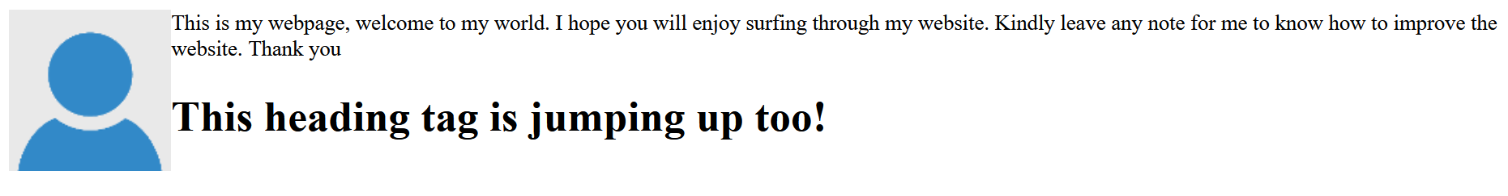
Float Property
    After floating, you need to clear the float if you don’t want other elements below the floated element to also jump up.
h1{
clear: both;
}
<h1 style="clear: both"> This heading tag is jumping up too!</h1>

Slide 30
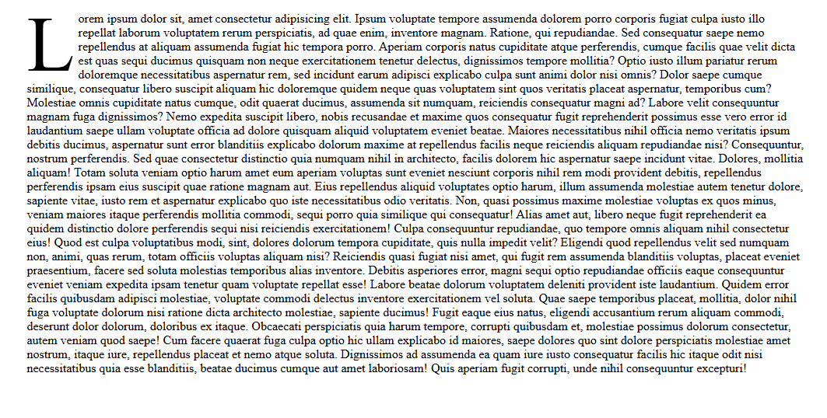
A Challenge for you!
Create a Newspaper-style (drop cap effect) design using the float property you’ve just learnt.

Slide 31
Adding Map with - HTML
Go to google map, pick the location you want to embed, then click on the share bar to display a share window, click on “Embed a map”, copy the entire code and add to your work file.
<iframe src="https://www.google.com/maps/embed?pb=!1m28!1m12!1m3!1d90525.30440296876!2d3.3042608274212872!3d6.592522725259003!2m3!1f0!2f0!3f0!3m2!1i1024!2i768!4f13.1!4m13!3e6!4m5!1s0x103b91a8ef5d1831%3A0xbd8d5c3a1498fa9!2sMM2%20Local%20airport!3m2!1d6.5844054!2d3.3332986!4m5!1s0x103b91e751d71485%3A0xf222ed73a7d14f9a!2sMuritala%20Airport%20Road%2C%20Ikeja%2C%20Lagos!3m2!1d6.5795772999999995!2d3.3226101!5e0!3m2!1sen!2sng!4v1759419180131!5m2!1sen!2sng" width="600" height="450" style="border:0;" allowfullscreen="" loading="lazy" referrerpolicy="no-referrer-when-downgrade"></iframe>

Slide 32
HTML - Entities
I am learning to code and currently learning HTML tags such as:
<p></p>, <h1></h1>, <img>, etc…

Slide 33
Char Dec Hex Name
₥ &#8357; 20A5 MILL SIGN
₦ &# 8358; 20A6 NAIRA SIGN
&nbsp;
; 20A7 PESETA SIGN
₨ &# 8360; 20A8 RUPEE SIGN
© 169 &copy; COPYRIGHT SIGN
« 171 &laquo; LEFT DOUBLE ANGLE QUOTATION
® 174 &reg; REGISTERED SIGN
€ &# 8364; 20AC EURO SIGN &euro;
₿ &# 8383; 20BF BITCOIN SIGN
" &quot; QUOTATION
& 38 &amp; AMPERSAND
' 39 &apos; APOSTROPHE
< 60 &lt; LESS-THAN
> 62 &gt; GREATER-THAN
€ 128 &euro; EURO

Slide 34
FINAL PROJECT
Create a multi-page website for a construction company, it should have 4 pages (Homepage, About Us, Services, Contact Us).
The website should be built using everything you’ve learnt in HTML so far. Fill each page with the necessary content.
Make the website look real
Submission should be before 12p.m on Friday, October 17th 2025.

